Slide 1
FAFSA IRS Data Retrieval Tool
Have you been selected for verification?

Slide 2
Verification and the IRS Data Retrieval Tool
OTC strongly encourages you to use the IRS Data Retrieval Tool to verify your income and wage information.
The tool provides FAFSA applicants and parents with the ability to transfer income information form the IRS to the FAFSA.

Slide 3
Benefits of the tool
Complete the FAFSA more easily and accurately.
Securely transfer IRS tax return information into your FAFSA.
OTC receives the updated tax return information within 3 business days

Slide 4
Irs tool is available through the FAFSA website
www.fafsa.ed.gov

Slide 5
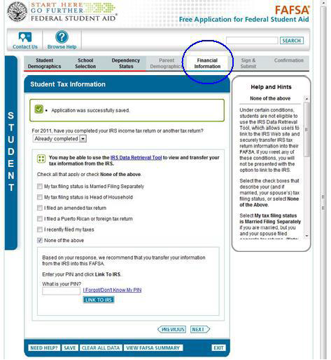
Go to “financial information” section of fafsa
If you are able to check none of the above, you are eligible to use the Tool.

Slide 6
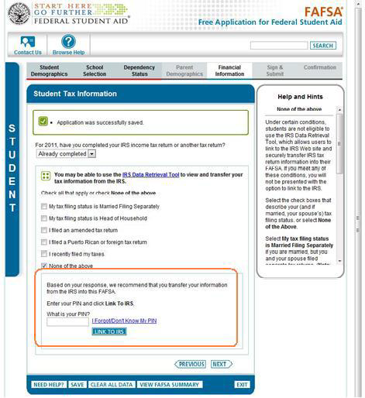
How to “Link to IRS”
If you are eligible to use the IRS Data Retrieval Tool, you will be prompted to:
1. Enter your FAFSA PIN number
2. Select Link to IRS

Slide 7
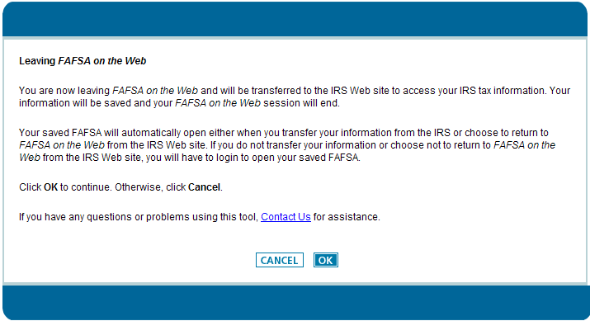
Leaving FAFSA on the web
You will receive confirmation that you are leaving FAFSA on the Web. Click OK to use the IRS Data Retrieval Tool.

Slide 8
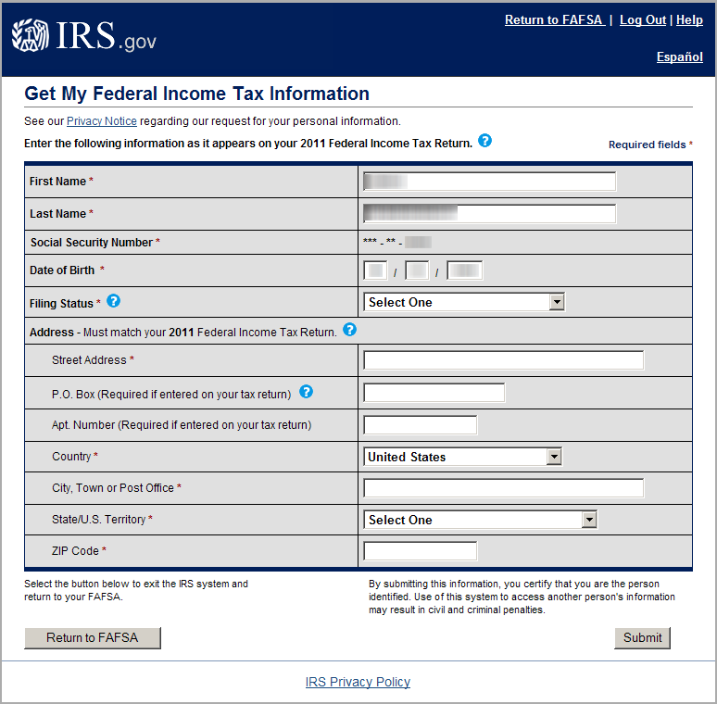
IRS.gov
Enter your information exactly as you filed it on your tax return.
If you used a middle initial put a space after your first name and then your middle initial.

Slide 9
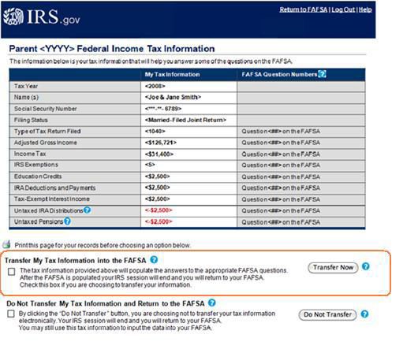
Irs data link
After you are connected to the IRS.gov website
Your tax information will display
Select the appropriate box
Select transfer now
Your IRS data will now be transferred to your FAFSA

Slide 10
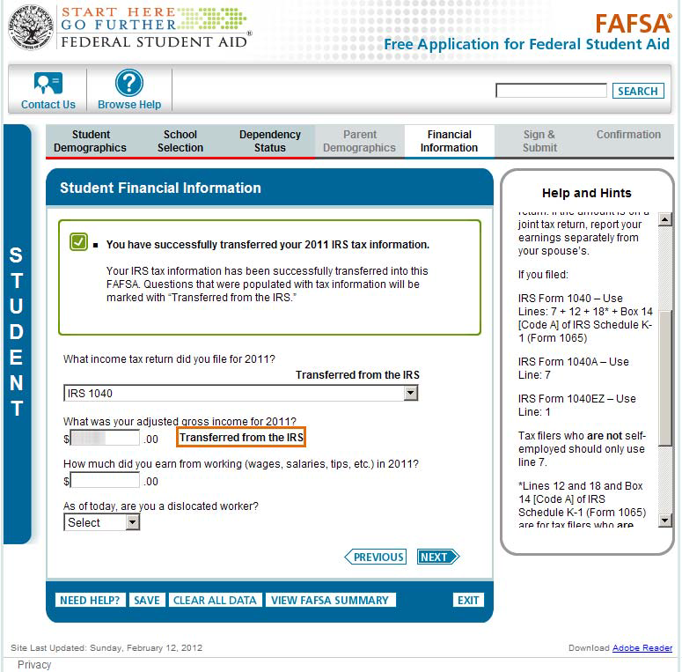
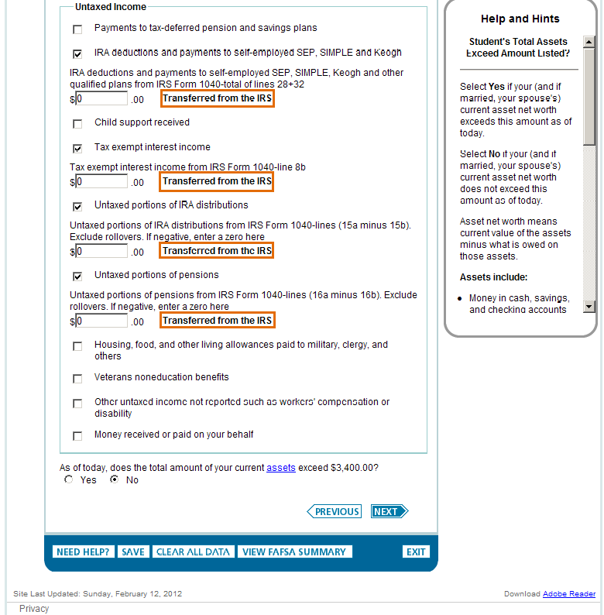
Transferred from the IRS
The data transferred will appear with the notation “Transferred from the IRS”
Do not change any of the fields which contain data transferred from the IRS

Slide 11
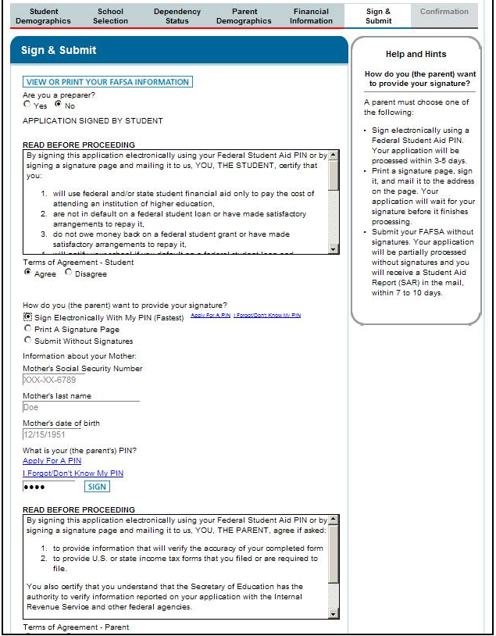
Sign and submit
Go to the sign and submit page

Slide 12
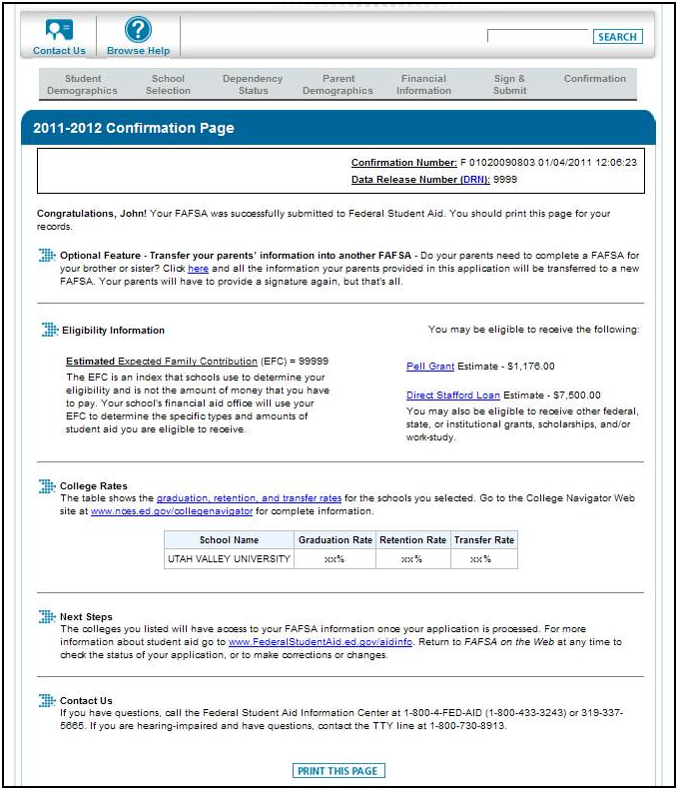
Confirmation Page
Once you see your confirmation page, you’ll know you’ve successfully submitted your FAFSA.

